Slide 1
Animal Recognition System —— Using Keras and TensorFlow
Zixuan Yu/Chung-Yang Li

Slide 2
Introduction
In current circumstance, although most of zoos have indicators for animals, yet sometimes we found that they look different from the signs. Our system using machine learning, keras, and TensorFlow, can improve the accuracy to recognize the different animals for people.

Slide 3
OUR PROCESS IS EASY
Reading
Input
Creating
Network
Layer
Prediction

Slide 4

Dataset
Our dataset contains 600 images which are classified as cat, dog, monkey, bird, lion and horse. It is downloaded from ImageNet, google image, and pexels.com.

Slide 5

Approach
Convolutional Neural Network (CNN)

Slide 6
Approach
Convolution Layer
Filter Size:3*3
Num Filter: 32
CAT
DOG
BIRD
LION
HORSE
MONKEY
Flatten Layer
Fully Connected Layer
Input
Images
Convolution Layer
Filter Size:3*3
Num Filter: 32
Convolution Layer
Filter Size:3*3
Num Filter: 32

Slide 7
Create Convolution Layer
Define
Weight
Create
Bias
Create
Convolution layer:
tf.nn.conv2d
Using
Max-pooling:
tf.nn.max_pool
Activation Function:
tf.nn.Selu

Slide 8
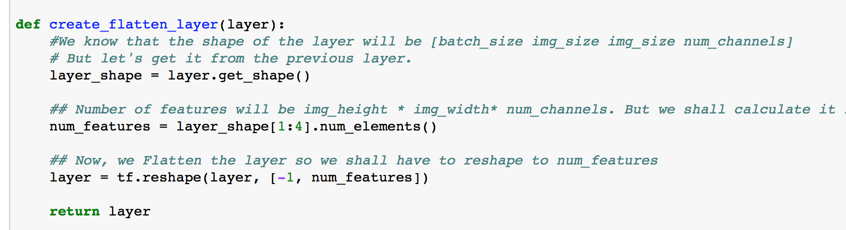
Create Flatten Layer

Slide 9
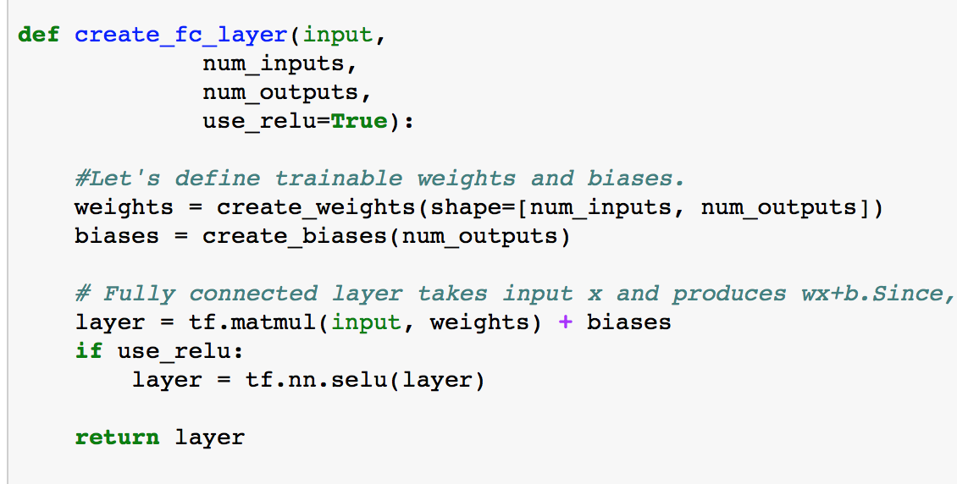
Create Fully Connected Layer

Slide 10
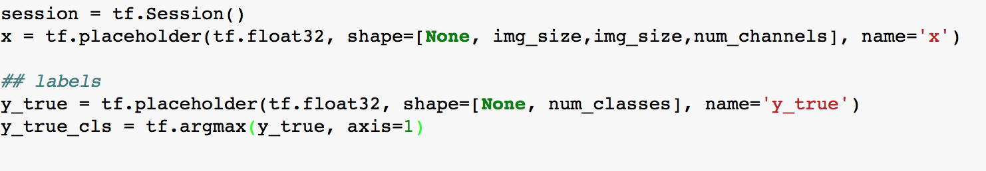
Placeholders and input

Slide 11
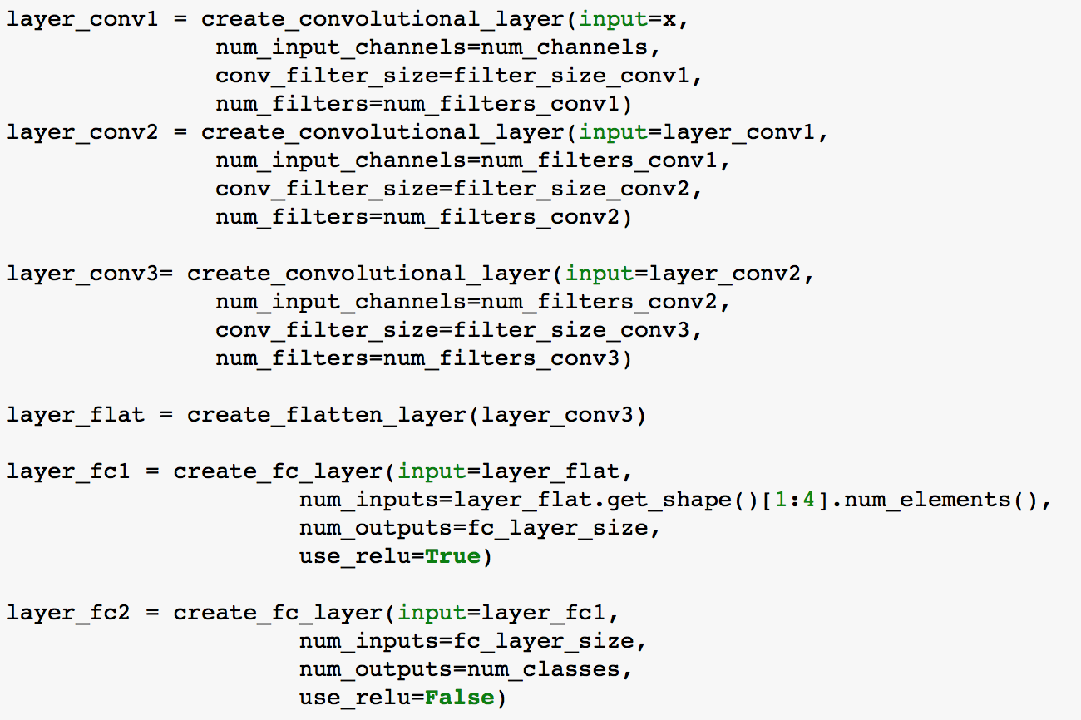
Network Design(TensorFlow)

Slide 12
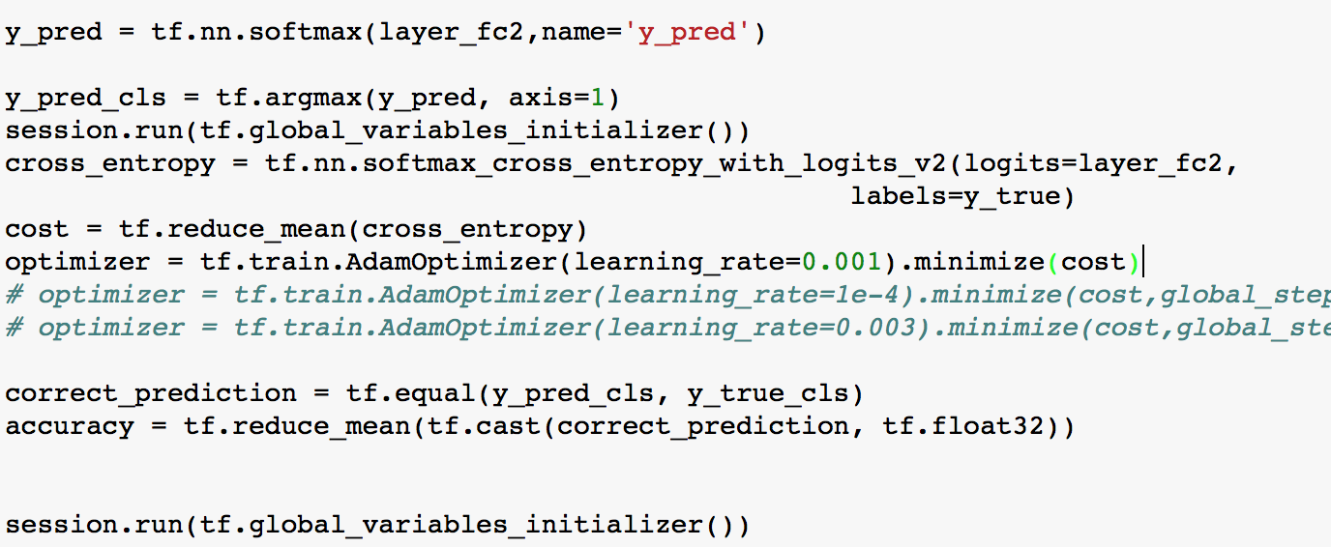
Predictions and Optimization

Slide 13
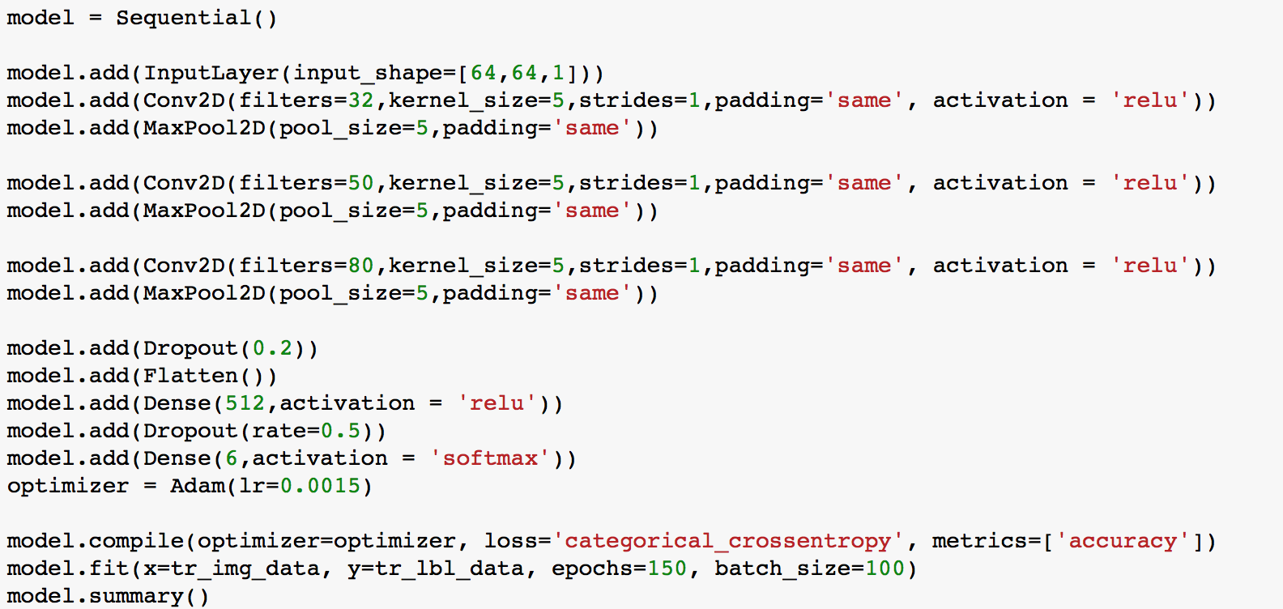
Model(Keras)

Slide 14
Evaluation
Cost Function: | Cross Entropy | vs | Hinge
Gradient estimation: | ADAM | vs | Stochastic Gradient Descent
Activation Function: | SELU | vs | RELU
Iteration: | 1250 | vs | 250

Slide 15
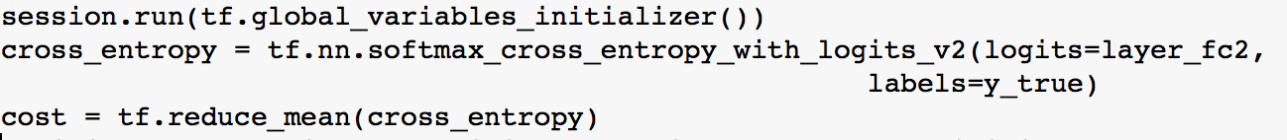
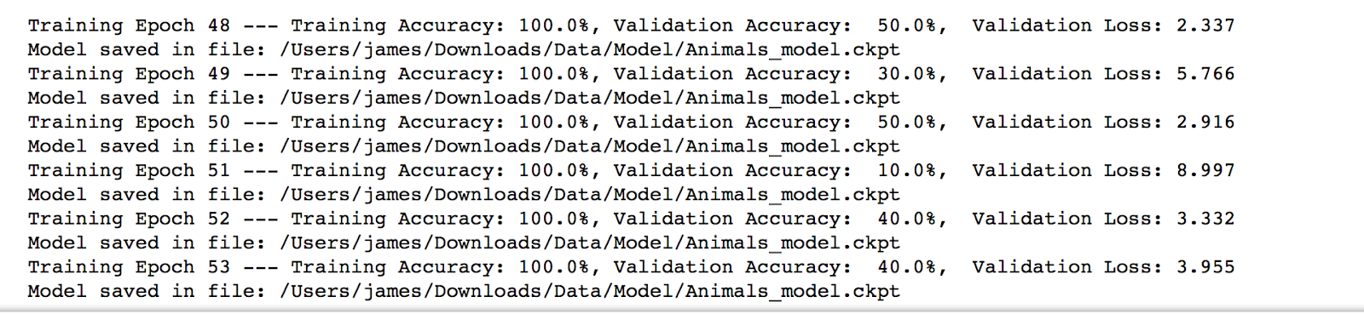
Cost Function: Cross Entropy

Slide 16
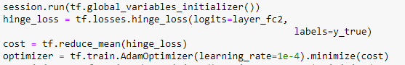
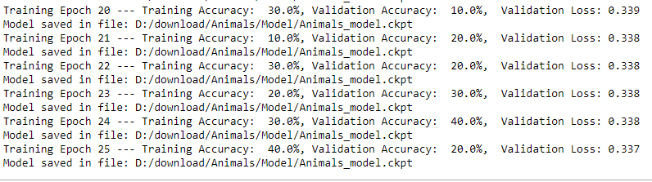
Cost Function: Hinge

Slide 17
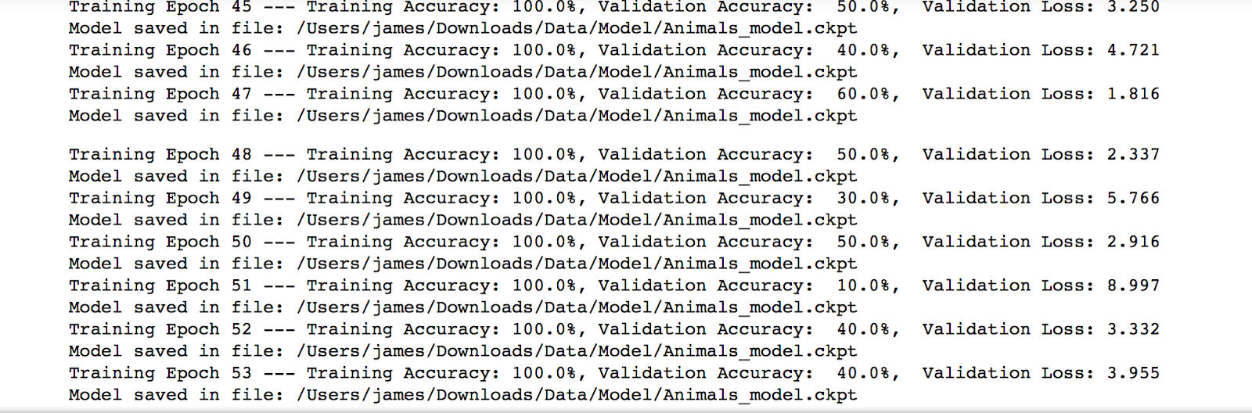
Gradient estimation :ADAM

Slide 18
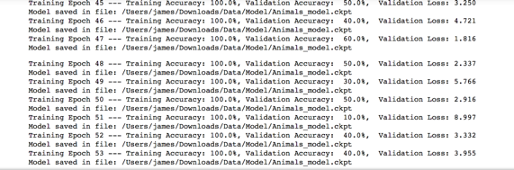
Gradient estimation : Stochastic Gradient Descent

Slide 19
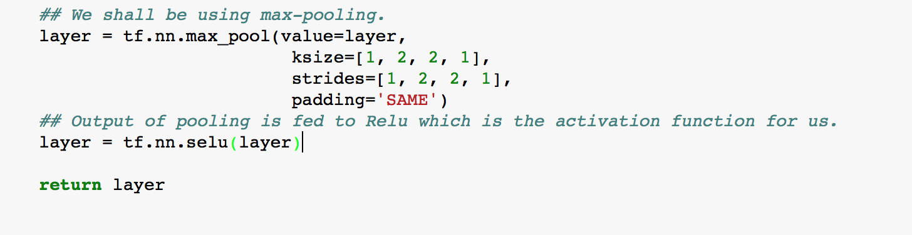
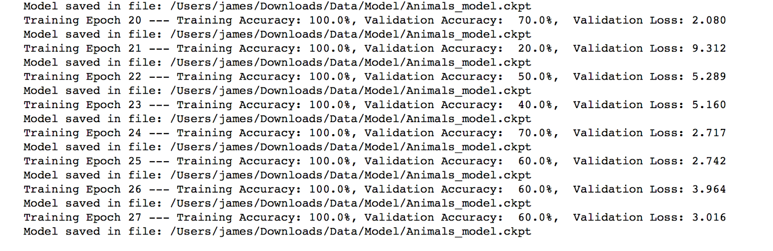
Activation Function: SELU

Slide 20
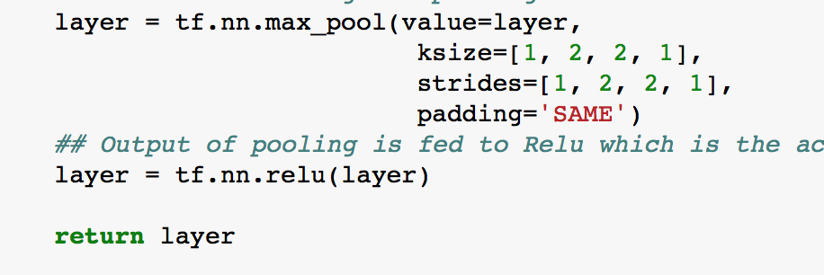
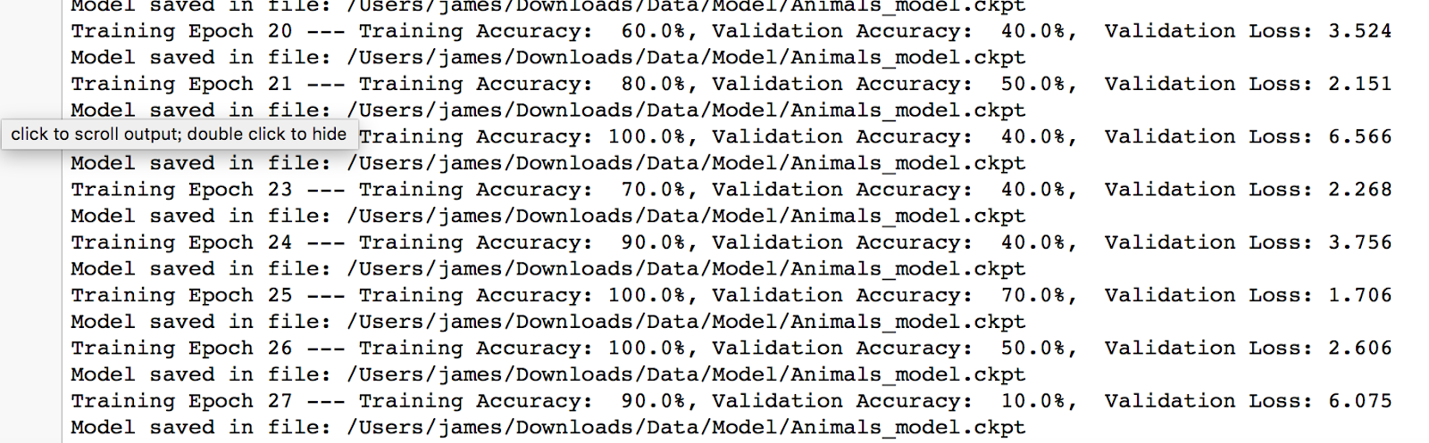
Activation Function: RELU

Slide 21
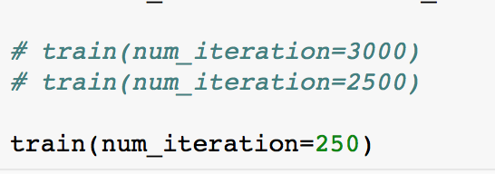
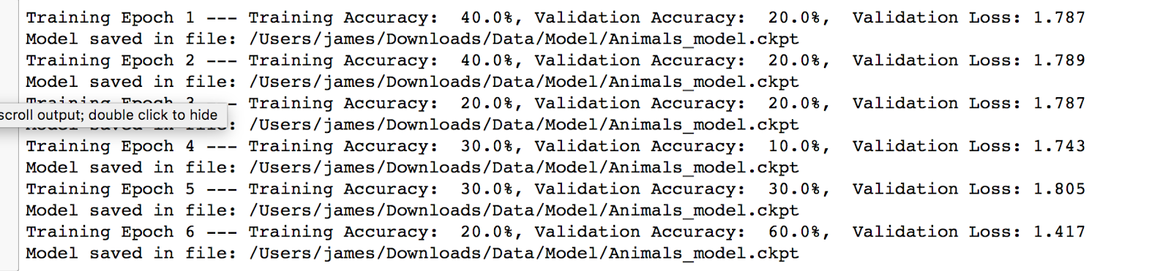
Iteration:250

Slide 22
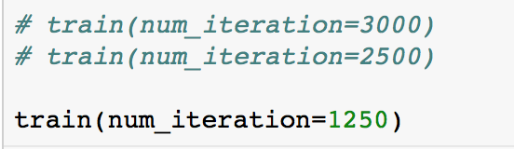
Iteration:1250

Slide 23
Conclusion
Cost Function:
Cross Entropy
Activation
function:
Selu
Gradient
estimation:
ADAM
Iteration:
1250

Slide 24
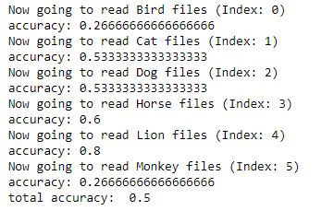
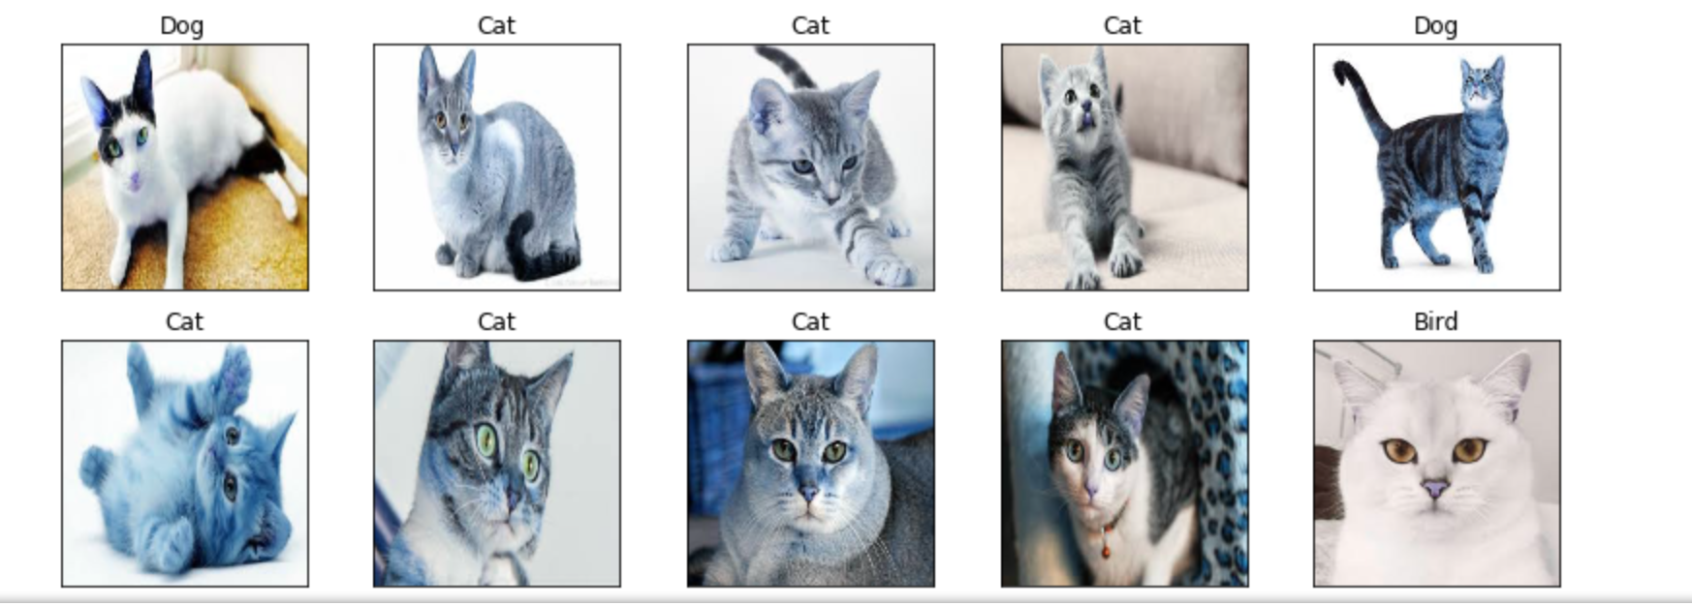
Result
We have reach to 50% accuracy with following hyper-parameter:
Activation function: Selu
Cost function: Cross Entropy
Gradient estimation: ADAM
Learning rate: 0.0003
Iteration: 1250

Slide 25
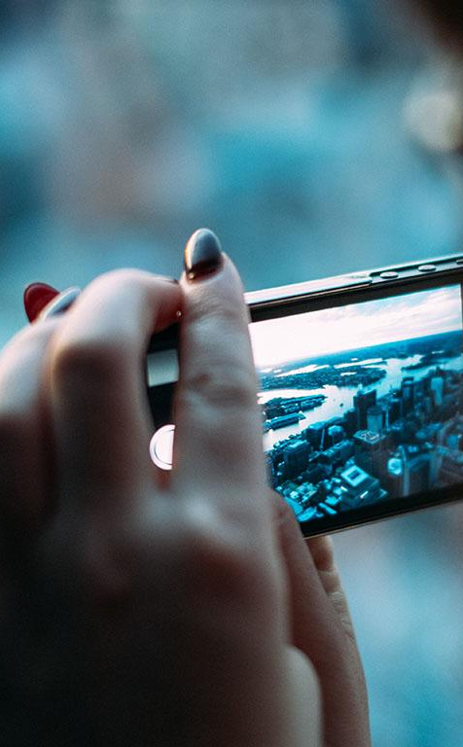
Future Scope
Because we download each animal image on our own, only 100 images for each animal already able to train our model and get 50% accuracy. We believe if we could have sufficient data for training, our model could accurately classify animals.

Slide 26
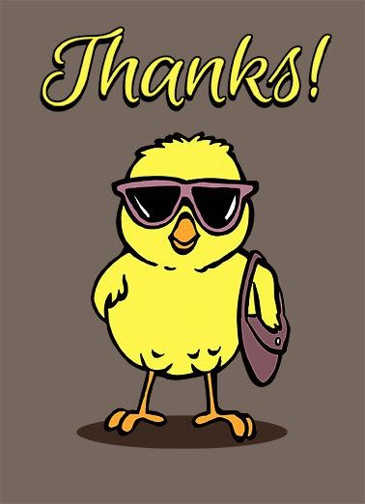
Thank you

